Slide 1

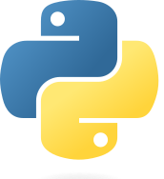

Python Programming with ChatGPT
Lachlan McKinnie, PhD student in bioinformatics and red algal genetics, University of the Sunshine Coast
Lachlan.McKinnie@research.usc.edu.au

Slide 2
Who am I
Overview
PhD student at the University of the Sunshine Coast
Researching algal genetics, with a focus on biosynthetic pathways
My research is entirely bioinformatics based
Main coding skills in Python, as well as web design with HTML, CSS and a little bit of JavaScript
Big fan of getting ChatGPT to code new things for me

Slide 3
Session plan
Overview
Overview
Software installation: Download Python IDE, access ChatGPT
Introduction: What is Python? What can it be used for?
Basic introduction to Python coding with ChatGPT
How to generate graphs using Python code generated by ChatGPT
Performing statistical tests with ChatGPT and Python
Altering and sharing ChatGPT scripts
Further applications

Slide 4
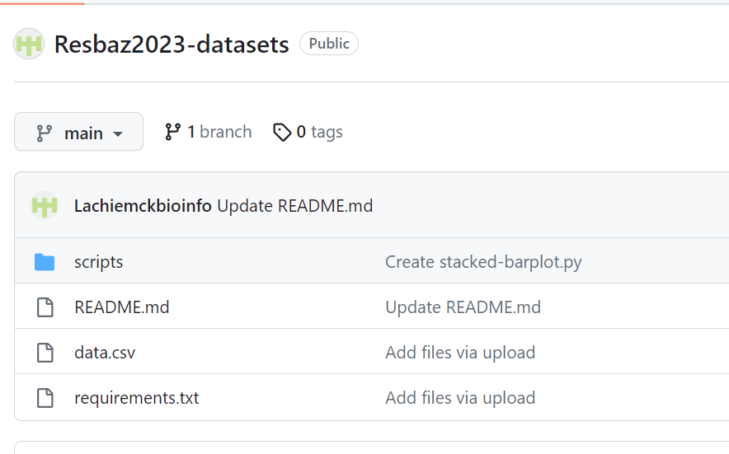
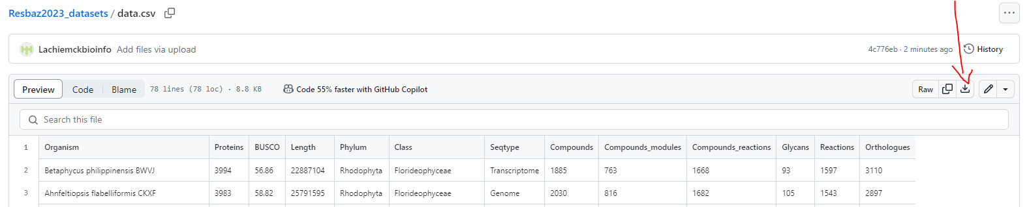
Data we will be using
Getting started
We will be analysing data from an Excel spreadsheet in csv format
Download from GitHub: https://github.com/Lachiemckbioinfo/Resbaz2023-datasets
Click on file data.csv, and select download raw
Save it to where your Python scripts will be saved
Feel free to use your own data instead if you want!

Slide 5
Shern’s data
Getting started
Shern’s Python course
https://github.com/srtee/prog-with-python-resbaz

Slide 6
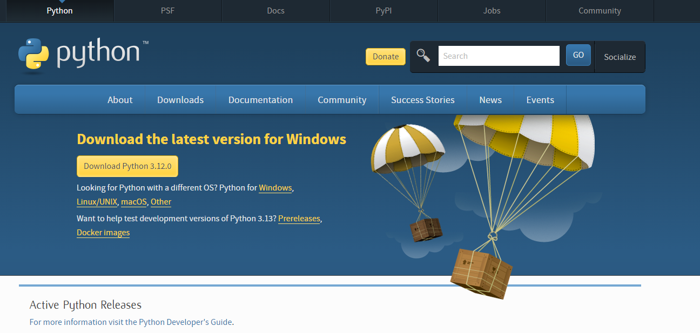
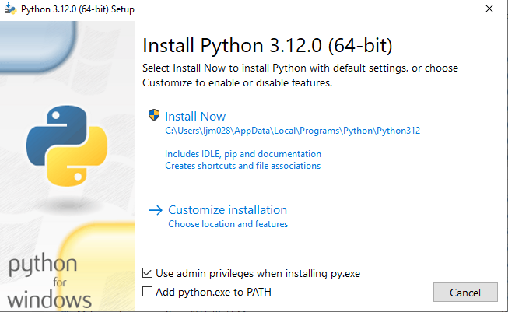
Installing Python
Getting started
Download free from Python website
https://www.python.org/downloads/

Slide 7

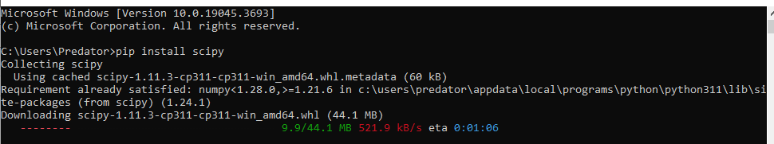
Python libraries
Getting started
Essential libraries:
numpy: Maths and number manipulation
pandas: Controls
matplotlib: Graphing
Installation: go to command prompt/terminal
pip install <library>
Can chain multiple together at once

Slide 8
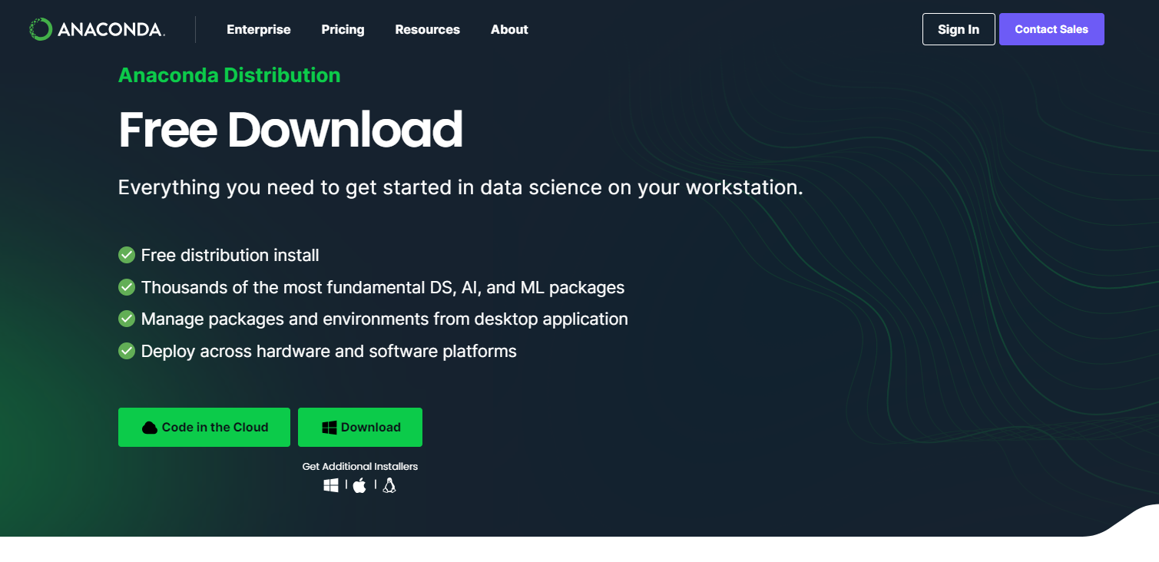
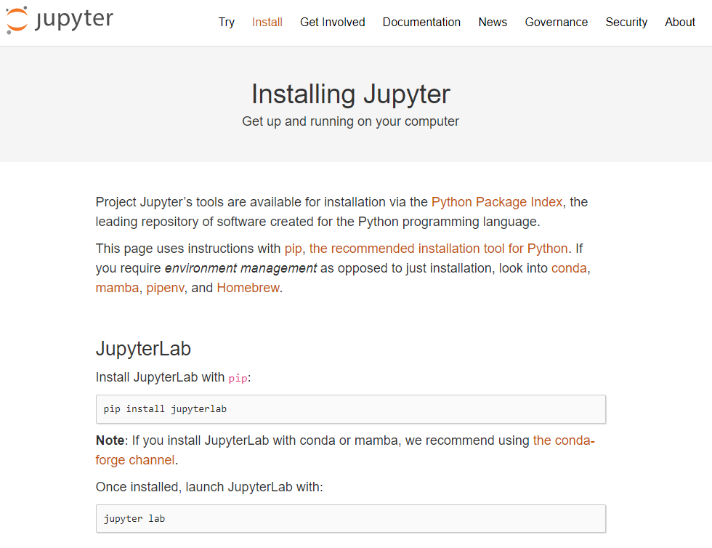
IDEs (Integrated Development Environment)
Getting started
Anaconda
https://www.anaconda.com/download
Includes Python
Jupyter Lab
https://jupyter.org/install
Requires Python

Slide 9
ChatGPT
Getting started
https://chat.openai.com/
Requires account to use
Accounts are free to make
Requires email address to make account
If you don’t want to make an account, I have some downloadable Python scripts that you can try out

Slide 10
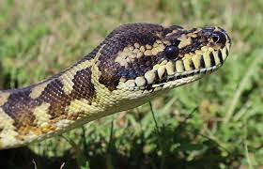
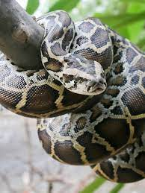
Python
Introduction
Pythons are non-venomous constricting snakes from the family Pythonidae
Very boopable snoots*
Pythons don’t make for good coders, but they can be good cuddle buddies
*Please do not boop the snoots of wild danger noodles.

Slide 11
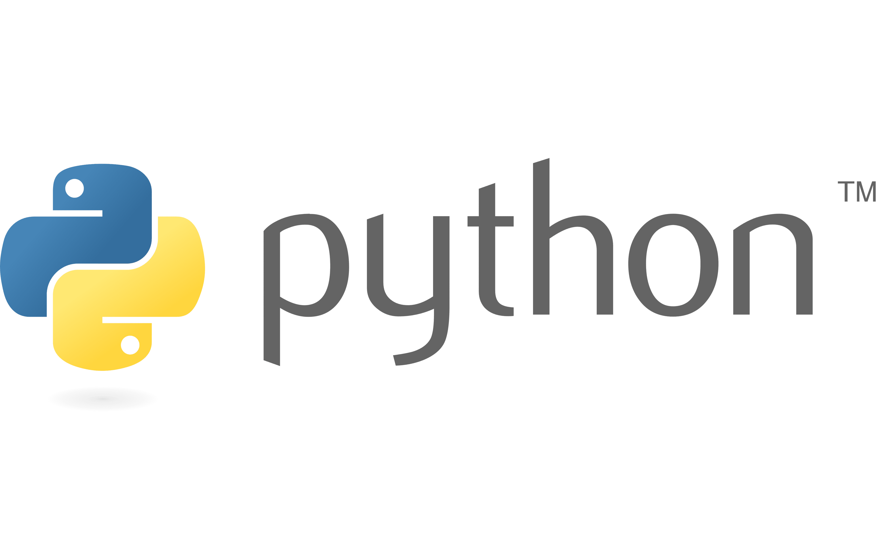
Python
Introduction
Widely used programming language
Highly extensible with modules, which are easy to download and install
Used in a large range of industries for many functions

Slide 12
ChatGPT
Introduction
ChatGPT is a Large Language Model (LLM)
Trained on large datasets of text data
Looks at existing patterns in text and uses that to predict which word should come next in an output
Has the entirety of several coding languages, including Python, available to it
IMPORTANT: Does not verify information or perform maths (though new paid release can do maths and look up websites)

Slide 13
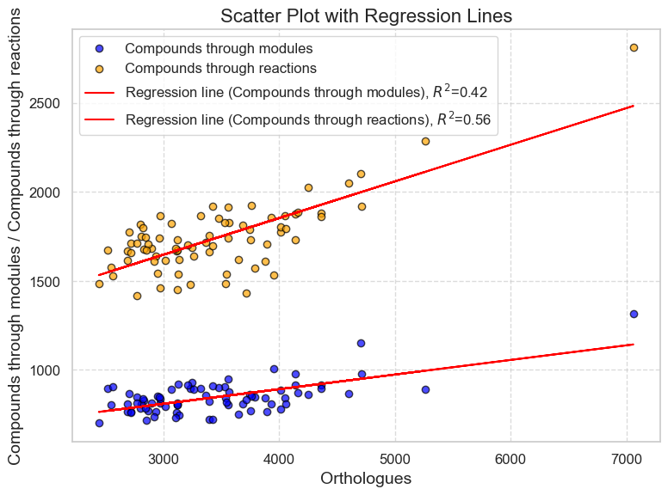
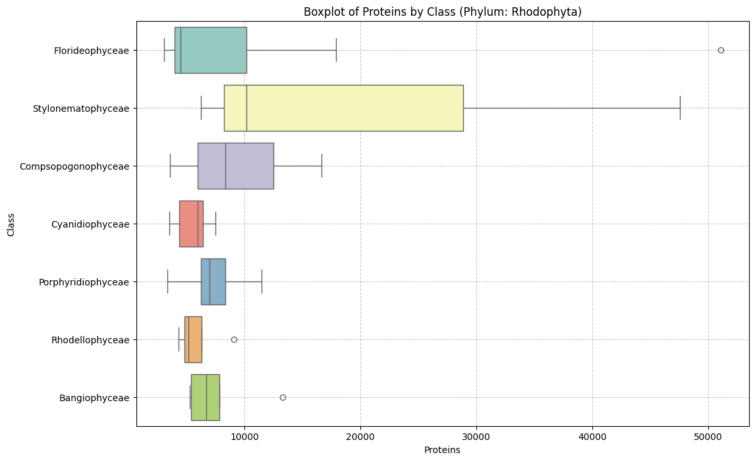
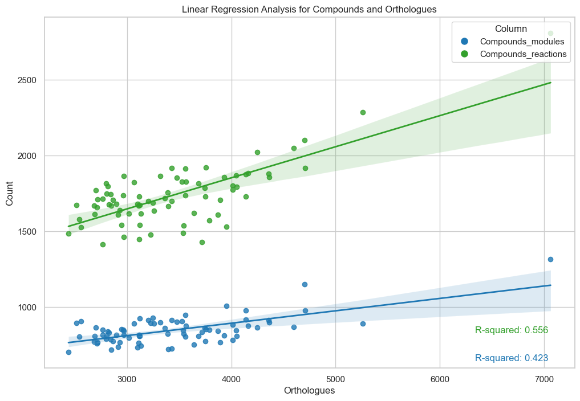
Plot examples
Introduction

Slide 14
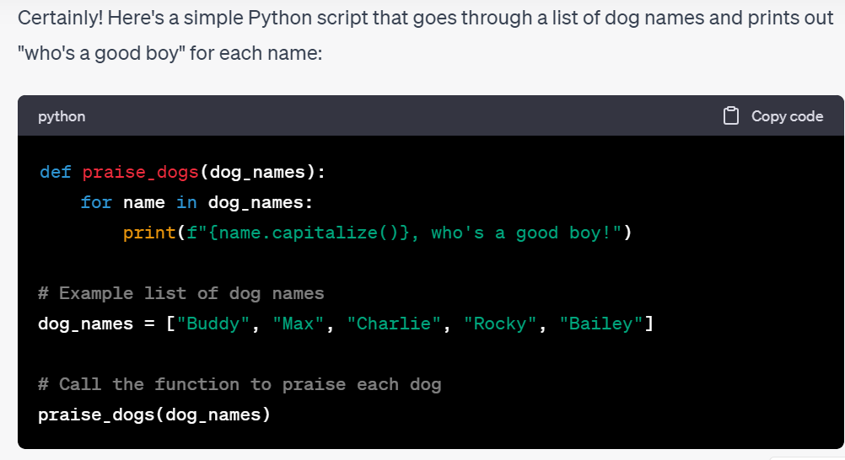
Task 1: Generating basic Python Script
Task 1
Log into ChatGPT and open up your Python environment
Ask ChatGPT to generate a simple Python script. For example:
Code a Python script to go through a list of dog names and say “who’s a good boy” name.

Slide 15
Task 1: Generating basic Python Script
Task 1
Review: how many different approaches did ChatGPT use to make this function?
Did it show you any new Python techniques?

Slide 16
Analysing data from a dataset
Task 2
We will be analysing data from an Excel spreadsheet in csv format
Email attachment
Download from GitHub

Slide 17
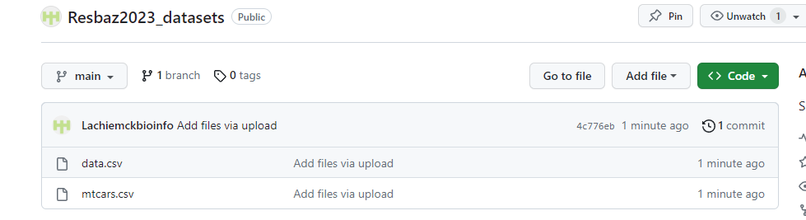
Analysing data from a dataset
Task 2
We will be analysing data from an Excel spreadsheet in csv format
Download from GitHub: https://github.com/Lachiemckbioinfo/Resbaz2023_datasets
Click on file data.csv, and

Slide 18
Analysing data from a dataset
Task 2
We will be making the following plots: bar graph, stacked bar graph, boxplot, and scatterplot
Use the data.csv file.

Slide 19
Bar graphs
Task 2a
Lets start with a simple bargraph.
Try the following question:
I have a csv file called data.csv that has both numeric and categorical data. In it, the column Seqtype shows whether a given item is a genome or transcriptome. Make a Python script using Pandas and Matplotlib to create a bar graph showing the numbers of genomes and transcriptomes

Slide 20
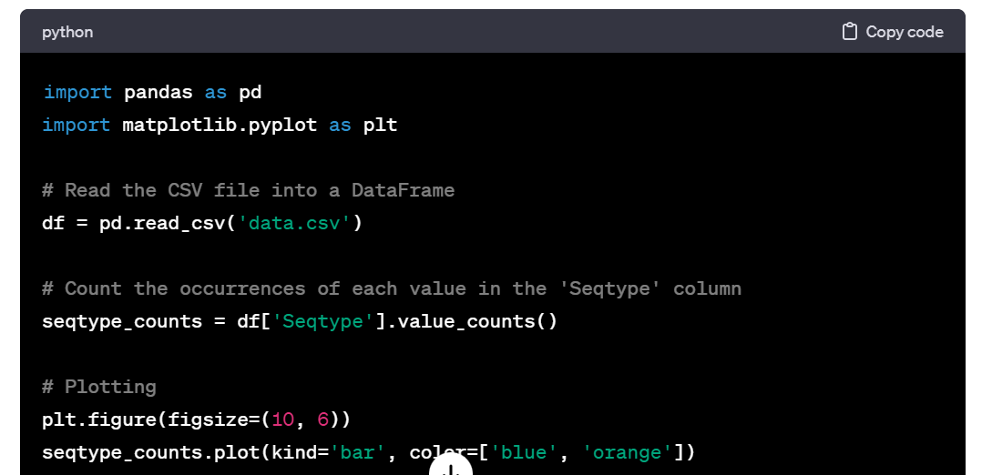
Bar graphs
Task 2a
Click Copy code
Paste into your Python environment

Slide 21
Bar graphs: improving results
Task 2a
Try editing the output with the following prompts:
Change the data input to the Scale column, which uses the categories Microalgae and Macroalgae
Change the graph so that it would be suitable for a scientific publication

Slide 22
Stacked Bar graphs
Task 2b
We can also do more advanced bar plots. Try:
Make a stacked bar graph using the Seqtype column, which has categorical values, with subcategories from the Class column
Improve: ask ChatGPT to make the plot wider, and make sure the legend does not overlap the plot itself.
Advanced: we are mainly looking for red algae (phylum Rhodophyta), however there are some green algae in this dataset. Ask ChatGPT to filter out items which do not belong to phylum Rhodophyta.

Slide 23
Scatterplots
Task 2b
For two sets of numerial data, we can do scatterplots.
Lets try the following: generate a Python script to make a scatterplot using the columns Proteins and Compounds
Advanced: try adding linear regression, or colour by category
You may need to specify to use only matplotlib, pandas and numpy. ChatGPT may code in other libraries, like seaborn or scipy. Seaborn adds more colours, while scipy does more advanced statistical analysis.

Slide 24
Scatterplots
Task 2c
Review: What new techniques did you learn from this?
See if you can make it look like a proper scientific graph

Slide 25
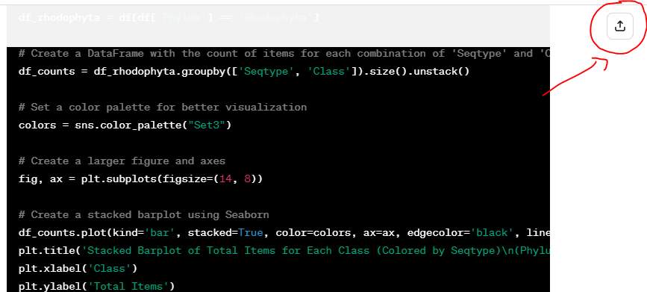
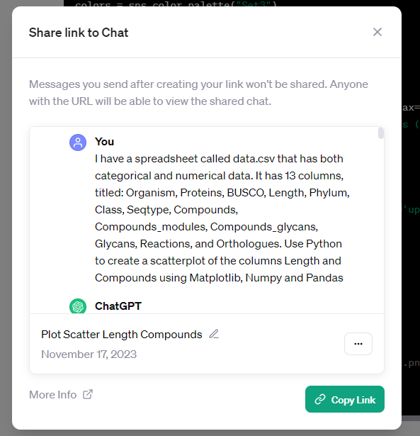
Sharing ChatGPT chats
Sharing
chats
Sometimes it is useful to share the chat you have with ChatGPT
Clicking the Share button will create a link to your chat that you can share

Slide 26
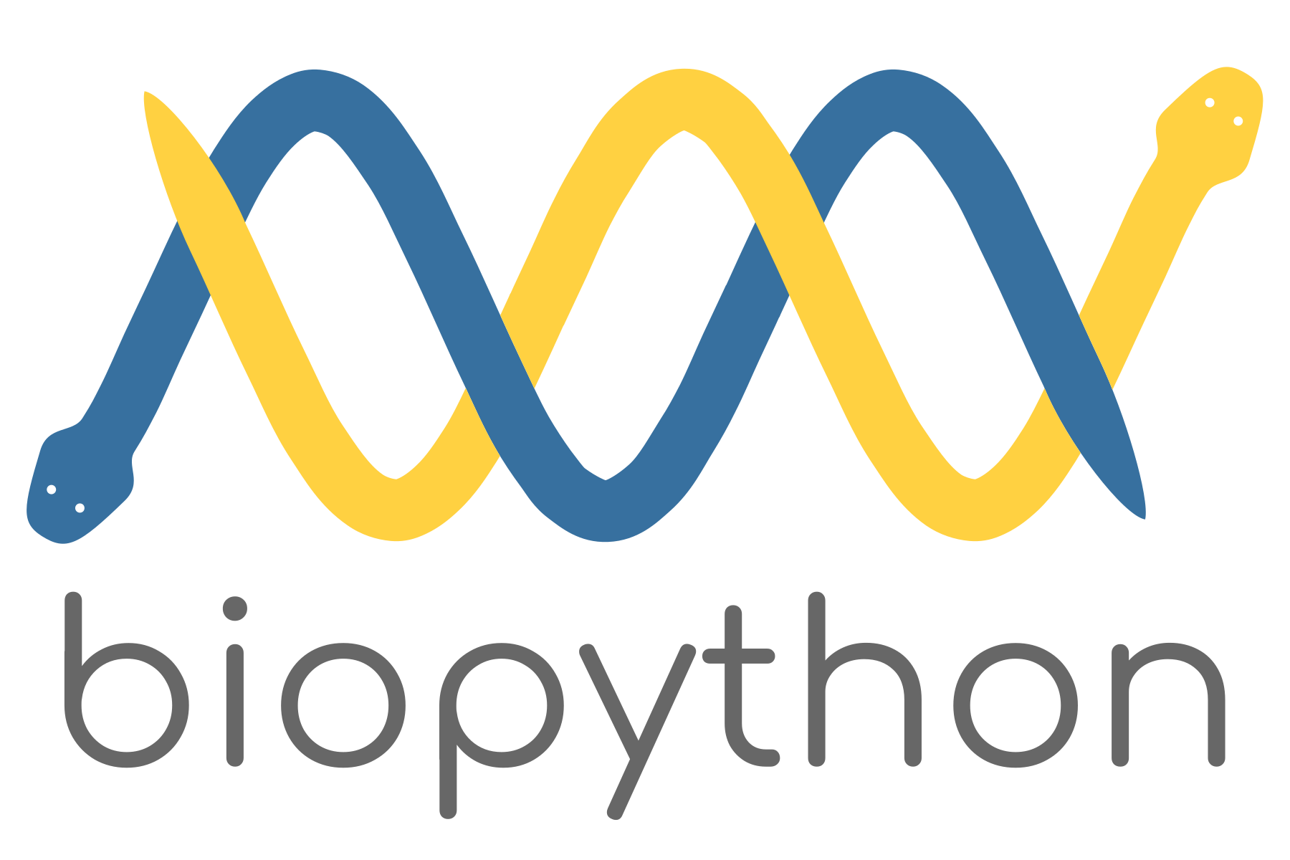


Further applications in Python programming
Conclusions
Web design with Flask and Django
Bioinformatics analysis with BioPython
Game design with Pygame

